Slide 1
Unit-3
Cont…

Slide 2
Recap….
Normalization:
The process of decomposing unsatisfactory "bad“ relations by breaking up their attributes into smaller relations
Normalization is carried out in practice so that the resulting designs are of high quality and meet the desirable properties
Normal form:
Condition using keys and FDs of a relation to certify whether a relation schema is in a particular normal form

Slide 3
Definitions of Keys and Attributes Participating in Keys
A super key of a relation schema R = {A1, A2, ...., An} is a set of attributes S subset-of R with the property that no two tuples t1 and t2 in any legal relation state r of R will have t1[S] = t2[S]
A Candidate key K is a super key with the additional property that removal of any attribute from K will cause K not to be a super key any more.
OR
Minimal Super Key with unique and not null values can be a candidate key
One of the candidate keys is arbitrarily designated to be the primary key, and the others are called secondary Keys / Alternate Keys
A Prime attribute must be a member of some candidate key
A Nonprime attribute is not a prime attribute— that is, it is not a member of any candidate key

Slide 4
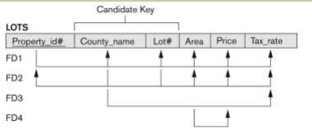
Example for Normalization
The above relation describes parcels of land for sale in various county of a state. Suppose there are 2 candidate keys as:
1. Property_ID
2. County_Name and Lot_No

Slide 5
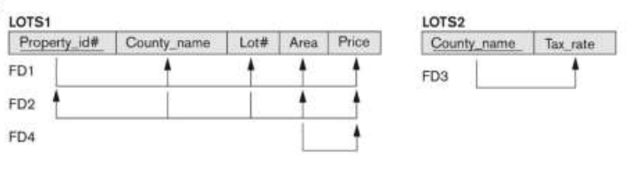
2 NF Conversion
Remove partial functional dependency
County_Name -> Tax_Rate

Slide 6
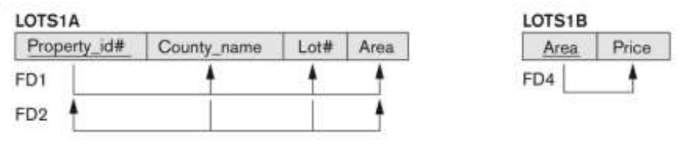
3 NF Conversion of relation LOT1
Here remove transitive dependency
Area -> Price and
Property_Id -> Area

Slide 7
BCNF – Boyce Codd Normal Form
BCNF is the advance version of 3NF. It is stricter than 3NF.
A table is in BCNF if every functional dependency X → Y,
X is the super key of the table.
For BCNF, the table should be in 3NF, and for every FD, LHS is super key.
General definition of 3NF is:
For any FD X->Y:
X is a super Key of R OR
Y is a Prime Attribute of R

Slide 8
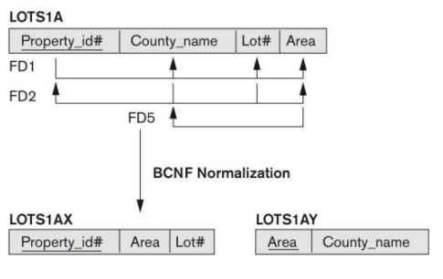
BCNF
In the above relation LOTs1A if we assume that the Lot size/ area is fix per county and they are from 2 county only
So in that case we can add one more FD i.e. Area -> County_Name
So, according to 3NF this is allowed FD as: Area is not a super key according to rule (i) but as rule (ii) says County_Name is a prime attribute.
But according to BCNF only one condition is allowed for FD is that the determinant must be a super key. So, Need to convert the relation LOTs1A into BCNF as shown below:

Slide 9
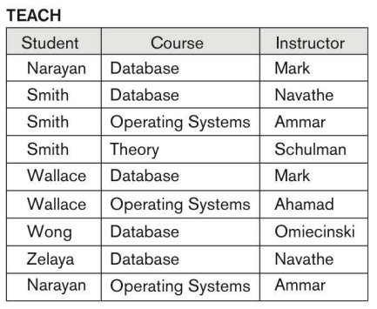

BCNF Example
Candidate Key:
{Student,Course}
FDs:
{Student,Course} -> Instructor
Instructor -> Course
Decomposition Rule:

Slide 10
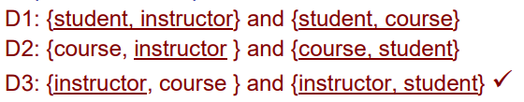
Conversion into BCNF
Out of all above 3 decomposition
Only D3 follows the decomposition rule for BCNF
So D3 is the only valid decomposition

Slide 11
Examples for Normalization
R = {Course_No, Sec_No, Off_Dept, Credit_Hrs, Course_Level, Inst_SSN,
sem, year, Days_Hrs, Room_No, No_of_Stud}
Functional Dependencies:
{Course_No} -> {Off_Dept, Credit_Hrs, Course_Level}
{Course_No, Sec_No, Sem, Year} -> {Days_Hrs, Room_No, No_of_Stud, Inst_SSN}
{Room_No, Days_Hrs, Sem, Year} -> {Inst_SSN, Course_No, Sec_No}

Slide 12
2NF:
Course_Master:
Course_Taken:
3NF
No Transitive Dependancies
BCNF: Decomposition of course taken as below – (use 3rd FD for the same)
Course_Details
Instructor_Load
Course_No | Off_Dept | Course_Hrs | Course_Level
Course_No | Sec_No | Sem | Year | Days_Hrs | Room_No | Inst_SSN | No_of_Stud
Course_No | Sec_No | Sem | Year | No_of_Stud
Sem | Year | Room_No | Days_Hrs | Inst_SSN
Course_No | Sec_No | Room_No | Days_Hrs

Slide 13
VIEW
To reduce redundant data to the minimum possible, to prevent all users from accessing all columns of a table and for data security reason, Oracle allows the creation of an object called a View
A view is mapped to a select sentence.
A table on which view is based is described in the from clause of the SELECT statement
It is stored only as a definition in Oracle’s system catalog
When a reference is made to a view, its definition is scanned, the base table is opened and a view is created on the top of the base table.

Slide 14
Syntax
Create view <View_Name>
AS Select <list of col_name> from table
Where col_name = experience
Group by <criteria> having <predicate>
NOTE:
“ORDER BY” clause can’t be used while creating a View
The column of the table are related to the view using One-to-One relationship

Slide 15
Operations can be performed on VIEW
Renaming the columns of a view
Create view V1 AS Select col_1 “c1”, col_2 “c2” from table
Selecting data set from the view
Select c1, c2 from v1;
With specific conditions, a view can be updated
View defined from single table
For inserting record in the View, it must include Primary Key and NOT NULL columns of the base table
For deleting or updating record in the view, it can Exclude Primary Key and NOT NULL columns of the base table

